Slide 1
Interested in doing Neuroimaging Research?
Apply to be an Advancing Diversity in Neuroimaging Research (ADNiR) Scholar!
First summer: get paid while working full time doing:
• 3 one-month rotations in neuroimaging labs of your interest
• training in neuroimaging methods (e.g. coding) and professional issues
Due Feb 1
Next 1 to 2 years in the lab you choose:
• get paid while working as a part-time research assistant
- Learn to design, conduct, and analyze neuroimaging data
- hands on mentoring from faculty and research team
- present and publish your research
→ Application and more details: https://ccbbi.osu.edu/adnir-initiative
The goal of the ADNIR program is to increase opportunities for traditionally underrepresented groups in neuroimaging research

Slide 2
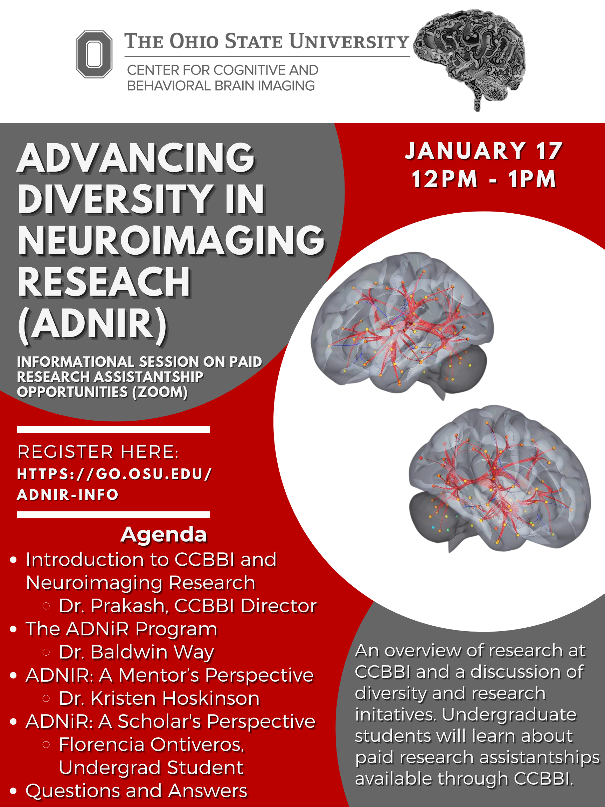
Zoom information session with neuroimaging faculty and current ADNIR scholar: Tuesday January 17th 12-1pm (Register here: https://go.osu.edu/adnir-info)
Want to learn more about how to apply for ADNiR?
January 17th
12-1pm

Slide 3
ARE YOU INTERESTED IN PARTICIPATING IN NEUROIMAGING RESEARCH STUDIES AT OSU?
Register to participate in brain imaging research studies
The Center for Cognitive and Behavioral Brain Imaging (CCBBI) at The Ohio State University conducts a wide range of brain imaging studies on participants of all ages. You have the opportunity to volunteer to participate in these studies. The amount of payment will depend on the research study, but will be communicated to you prior to your participation.
Sign up at: https://redcap.link/osu_research_registry
For more information, fill out our online survey or contact us at:
Phone: (614)-366-3523
Email: gorkalab@osumc.edu

